Slide 1

Smart Voting System
A DSA-Based Approach to Secure & Efficient Elections
Presented By:
Talha Khan (242210)
Ahsan Khan (242206)
Supervisor : Prof. Ammar Khan
Department of Creative Technology
(Air University Islamabad)

Slide 2
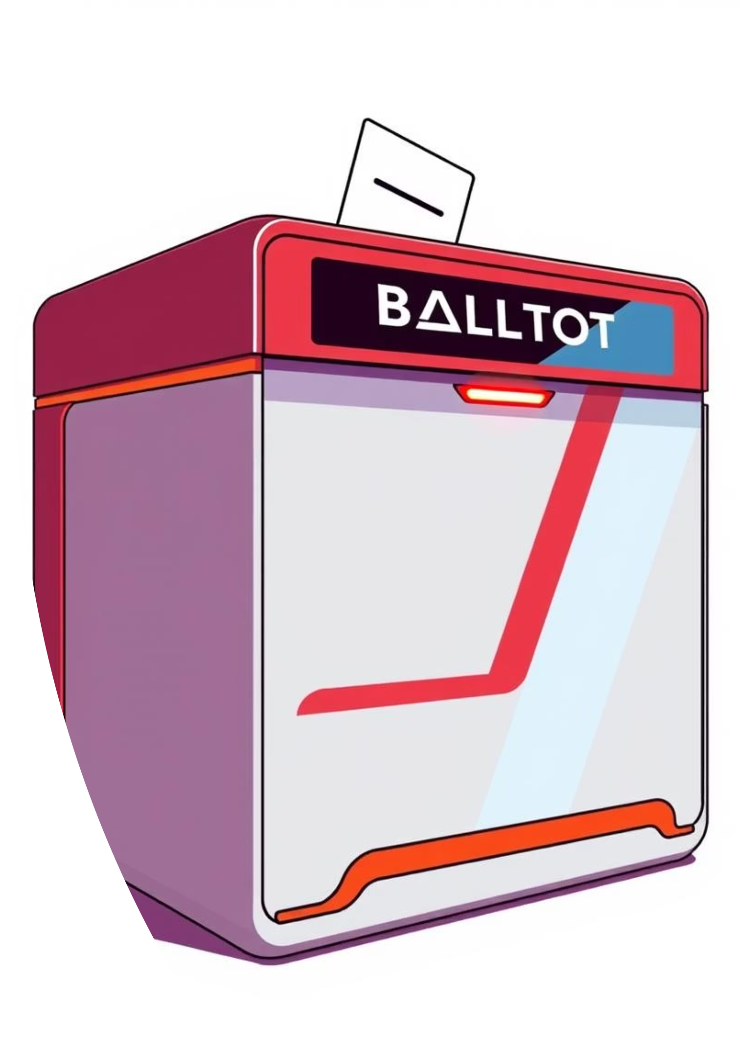
Introduction: Revolutionizing Elections
The Challenge: Manual System Flaws
Our Solution: A Digital Transformation
Prone to human error
Menu-driven C++ system
Slow processing times
Simulates real-world elections
Lacks transparency
Vulnerable to inefficiencies
Secure voter authentication
Live voting status & analytics
Unique "Undo Vote" functionality

Slide 3

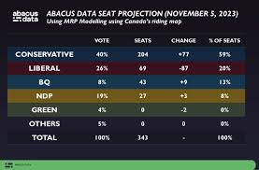
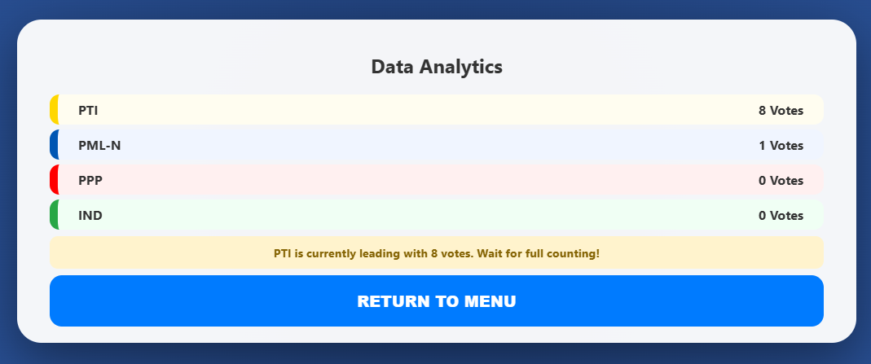
Problem Statement: Modern Election Demands
Handling Massive Data
Ensuring Integrity & Speed
Overcoming Scalability Issues
Modern elections require systems capable of managing vast voter datasets efficiently.
Zero duplicate voting and rapid verification are paramount for credible results.
Naive linear search systems become bottlenecks as voter numbers grow, causing delays.
Our goal is to design a system that leverages advanced Data Structures to optimize time complexity and enhance data security, addressing these critical challenges head-on.

Slide 4
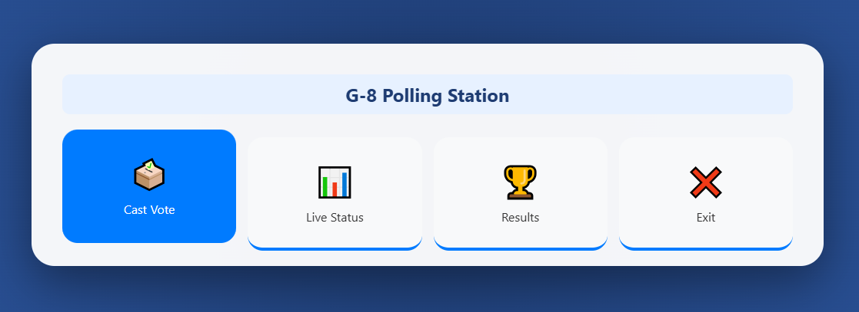
System Architecture: A Structured Approach
Modular Design
All operations are strictly confined to a user-selected polling station, preserving organizational hierarchy and data integrity.
Focused Scope
This modularity ensures clear responsibilities and prevents data leakage or unauthorized access across stations.
Separation of Concerns
Each critical feature is powered by a specific, highly optimized data structure tailored for its unique requirements.
Enhanced Efficiency
This design philosophy leads to a robust, efficient, and easily maintainable system.

Slide 5

Core Data Structures: The "Smart" in Smart Voting
Our project utilizes a multi-data structure approach for maximum efficiency and security.
Linked Lists: Voter Storage
Dynamic memory allocation for flexible voter registration without fixed size limits.
AVL Trees: Fast Authentication
Reduces search complexity to O(log n), preventing bottlenecks during voter verification.
Stacks: Undo Last Vote
Powers the unique "Undo Vote" feature using the LIFO (Last In First Out) principle.
2D Arrays: Real-time Counting
Enables constant-time access for instantaneous vote counting across multiple parties and stations.

Slide 6

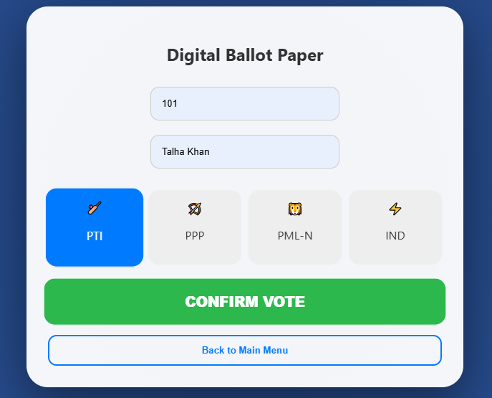
Functional Workflow: The Voting Process
Station Selection
The user first selects their designated polling station from the
available options.
Voter Authentication
Voters enter their unique ID and name; the system swiftly verifies their credentials via the optimized AVL Tree.
Casting & Interaction
Once authenticated, the voter can cast their vote, utilize the "undo vote" feature if a mistake is made, or view live results.
Security Check
The system immediately updates the voter's status to hasVoted = true, effectively preventing any duplicate votes.

Slide 7
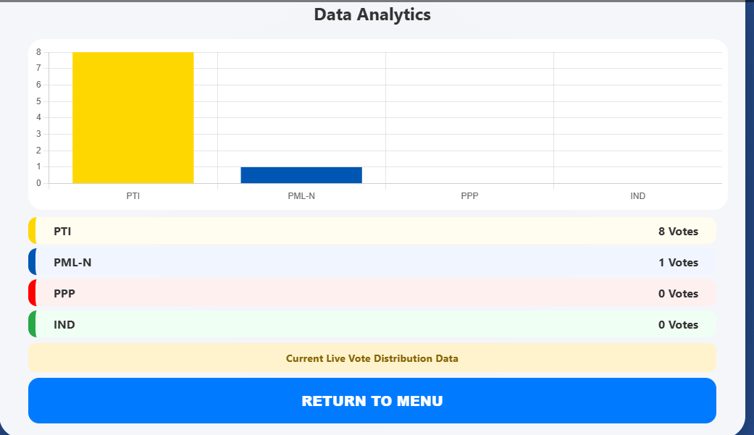
User Interface Showcase: Clarity & Transparency
Console-Based Efficiency
Visual Analytics
Our system features a clean, intuitive, menu-driven interface designed to guide users seamlessly through every step of the voting process. This ensures ease of use and reduces potential errors.
Experience real-time transparency with dynamic graphs and instant winning margin calculations. This visual feedback keeps both voters and administrators informed of the election's progress in real-time.

Slide 8


Advantages & Limitations: A Balanced Perspective
Optimized Search Performance
No Permanent File Storage
Data is reset after each session, requiring future implementation for persistence.
Leverages AVL Trees for fast and efficient data retrieval.
Modular & Maintainable Code
Single-User Console Interface
Designed for easy updates, extensions, and future development.
Currently limited to a single user at a time; a GUI is planned for multi-user access.
Strict Error Handling
Robust checks for unregistered or duplicate voters ensure election integrity.

Slide 9



Conclusion & Future Work: Building on Innovation
Project Conclusion
This project successfully demonstrates how foundational Data Structure and Algorithms concepts—including Linked Lists, AVL Trees, Stacks, and Arrays—can be effectively integrated to solve complex, real-world logistical challenges with high efficiency and security.
Implementing File Handling
Our next step is to integrate persistent data storage to ensure election records and voter information are retained across sessions.
Developing a GUI-based Interface
We aim to transition from the console to a graphical user interface for enhanced accessibility and a more intuitive user experience.
Adding Advanced Encryption
To further bolster security, we plan to implement sophisticated encryption protocols for all sensitive voter data and election results.

Slide 10

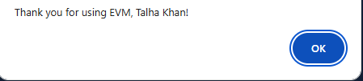
Thank You!
Thank you for your attention.
Questions?
"Thank you for using EVM!"

